Slide 1
How Can BCBB’s Computational Resources Help Advance Your Research?
Darrell Hurt, PhD
Chief, Bioinformatics & Computational Biosciences Branch, OCICB
“Bioinformatics is the creation of tools (algorithms, databases) that solve problems. The goal is to build useful tools that work on biological data. It is about engineering.”
“Computational biology is the study of biology using computational techniques. The goal is to learn new biology, knowledge about living systems. It is about science.”
Russ Altman Chair of the Dep’t of Bioengineering & Director of the Program in Biomedical Informatics Stanford University Medical School, California, USA

Slide 2
Slide Source: A. S. Fauci

Slide 3
“There are no non-computational fields.”
— Michael Tartakovsky, NIAID CIO, ca. 2004
Therefore
“Computation is a laboratory tool.”
and
“Data centers are research instruments.”
— Michael Tartakovsky, NIAID CIO, 2019
Inspired in part by Ari Berman, BioTeam, Inc.

Slide 4
NIAID
OD
IOD
OSMO
Extramural
VRC
DIR
DCR
DMID
DAIDS
DAIT
Intramural
OCICB
OAS: AOs, etc.
OWER: “HR”
OWS: “space”
OCGR: “comms”
ODSET: new!
LV
LB
LPVD
RTB
Kristi
CSB: “LAN guys”
OEB: network, H drives, etc.
SEB: AMBIS, NPMP, Tableau, etc.
BPIMB: SharePoint, EDRMS, etc.
IBRSP: ICERs (Mali, Uganda, etc.)
BCBB: “bioinformatics”
Notes:
The origin of BCBB was in late 2004, when the ”Bioinformatics & Scientific IT Program” was formed.
The mission of BCBB is to harness biomedical informatics, scientific computing, and data science techniques to offer innovative products and services that participate in and foster intramural, extramural, and international clinical and basic research to reduce human suffering caused by infectious, immunologic, and allergic diseases.
“Biomedical Informatics” is essentially the superset of bioinformatics and medical informatics; “Biomedical informatics … studies and pursues the effective uses of biomedical data, information, and knowledge for scientific inquiry, problem solving, and decision making, … to improve human health.” — AMIA
“Computational Science” (or “Scientific Computing”) tends to refer more to the use of simulation techniques (differential equations, molecular dynamics, etc.) with high-performance computing; it often includes the writing of code.
“Data Science” (deprecated term: “Computational Statistics”) tends to refer to computationally-intensive data analysis. It is the infusion of computer science with statistics and often includes learning software to do ”big data” analyses.
“A data scientist is someone who blends, math, algorithms, and an understanding of human behavior with the ability to hack systems together to get answers to interesting human questions from data.” — Hilary Mason
Data scientist = a data analyst who lives in California

Slide 5
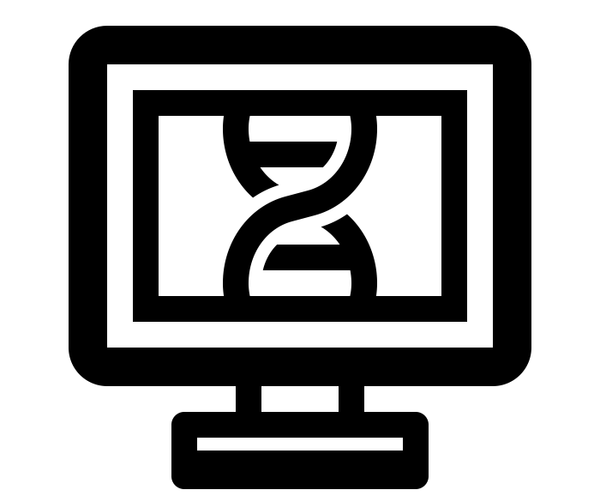
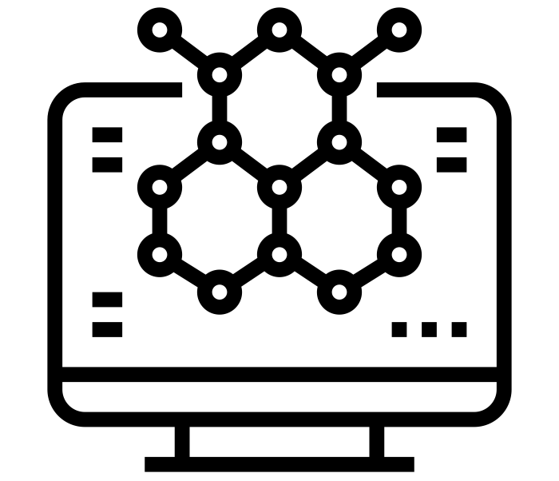
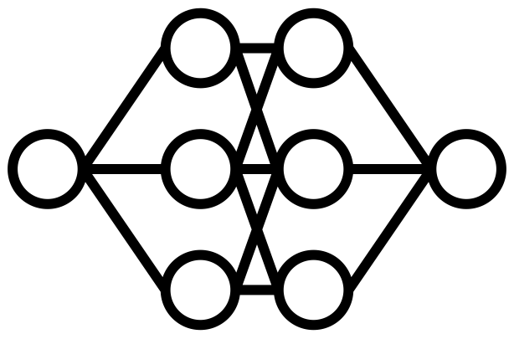
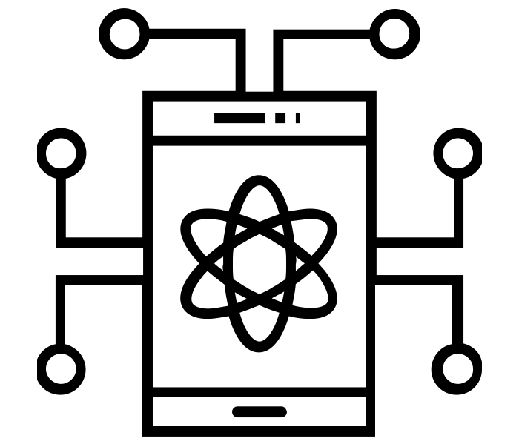
‘Omics
Application of biological principles to understand data captured from an entire biological system
Often benefits from elastic compute
Ex.: variants; expression; relative abundance
Simulations & Modeling
Often needs HPC
Creates large data from small input; must be crunched
Ex.: molecular dynamics; some phylogenetics, statistics
Imaging & AI/ML/DL
Capture and analysis of data expressed in 2D or higher dimension images
Often benefits from GPU
Typical problems: segmentation, registration, 3D reconstruction
Ex.: computer vision; computer-aided detection
“The Heart of 21st Century Biomedical Research”
“Bioinformatics” Extracting biomedical knowledge & insights from biomedical information
Visualization
Viz is the end goal in itself, but often generates hypotheses
Often needs exotic hardware
Challenge: throughput
Ex.: Mixed Reality; high-rez; multi-dimensional; 3DP/AM
Informatics & Data Science
Science of processing data for storage and retrieval
Often benefits from Hadoop and/or NoSQL
Computationally-intensive data analysis (formerly “computational statistics”)
Ex.: longitudinal studies; epidemiology
Notes:
Although many of these fields have been around for a long time, their current incarnations are vastly different and of much greater scale than when BCBB was founded.
Titan/Krios 1.1 PB/year
OLD DIVISIONS
–Omics
Molecular modeling & simulation
Pathways & network analysis
Phylogenetics & evolutionary biology
Biostatistics & experimental design
Computational Science (or Scientific Computing): the use of simulation techniques (e.g. molecular dynamics) with high-performance computing; it often includes the writing of code.
NoSQL, on one hand, is about real-time, interactive access to data. NoSQL use cases often entail end user interactivity, like in web applications, but more broadly they are about reading and writing data very quickly.
Hadoop, on the other hand, is about large-scale processing of data. To process large volumes of data, you want to do the work in parallel, and typically across many servers. Hadoop manages the distribution of work across many servers in a divide-and-conquer methodology known as MapReduce.
Calculating average income? Ask a relational database.
Building a shopping cart? Use a key-value Store.
Storing structured product information? Store as a document.
Describing how a user got from point A to point B? Follow a graph.

Slide 6
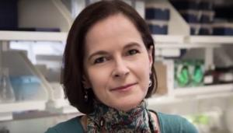
Microbiome Research
https://nephele.niaid.nih.gov
https://metagenote.niaid.nih.gov
Nephele & METAGENOTE
Yasmine Belkaid, PhD
DIR/LISB
Nephele: more than 150 jobs/month by more than 160 registered users; truly Agile, DevOps with automated testing; 14 publications
METAGENOTE: 34 registered users from 8 labs; leverages ontologies and standards
Notes:
Nephele: more than 150 jobs/month by more than 160 registered users; truly Agile, DevOps with automated testing; 14 publications
METAGENOTE: 34 registered users from 8 labs; leverages ontologies and standards

Slide 7
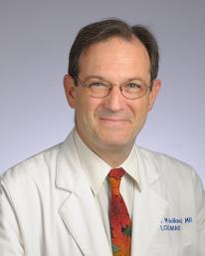
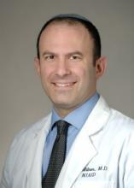
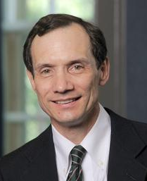
Clinical Genomics (GRIS)
Steve Holland, MD
DIR Director
Josh Milner, MD
Chief, DIR/LAD
Mike Lenardo, MD
DIR/LISB
GRIS integrates patient, family, and genomic data and provides tools for analysis
Nearly 6000 patient records and nearly 1300 human genomes
Users: 160 users (30 PIs, 12 Labs, including one from NHLBI)
Notes:
GRIS integrates patient, family, and genomic data and provides tools for analysis
Nearly 6000 patient records and nearly 1300 human genomes
Users: 160 users (30 PIs, 12 Labs, including one from NHLBI)

Slide 8
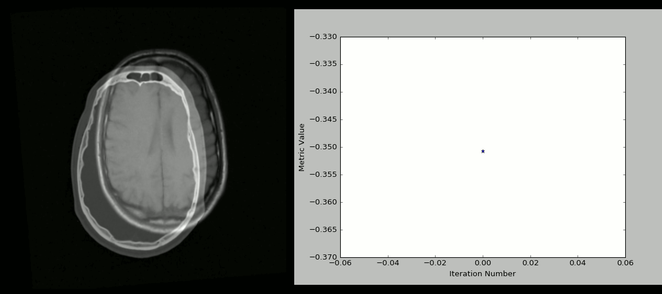
Simple ITK
https://simpleitk.org
The National Library of Medicine Insight Segmentation and Registration Toolkit.
“Engineering and Algorithm Design for an Image Processing API: A Technical Report on ITK - the Insight Toolkit”
T. S. Yoo et al., Stud. Health Technol. Inform., 85, pp. 586-592, 2002.
Notes:
The animation is a visualization of a rigid CT/MR registration process created with SimpleITK and Python.

Slide 9
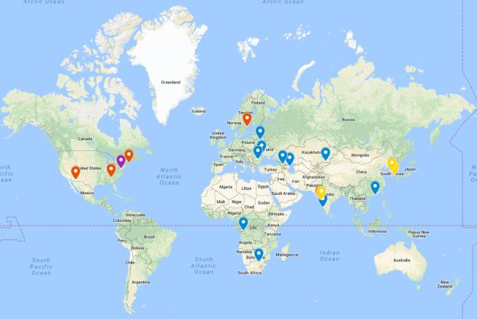
TB Portals
Partner country sites
Data feeds
Scientific collaborations
https://tbportals.niaid.nih.gov
More than
3000 patient cases
2200 CTs
2800 CXRs
1200 microbial genomes
11 publications
Notes:
3000 patient cases, more than 2200 CTs, more than 2800 CXRs, more than 1200 microbial genomic sequences
More than 11 publications

Slide 10
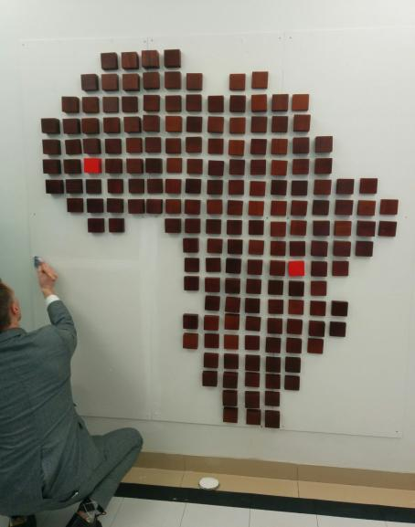
African Centers of Excellence in Bioinformatics and Data-Intensive Sciences
Bamako, Mali
Kampala, Uganda
https://ace.niaid.nih.gov

Slide 11
Provisioned and Supported Software
Includes training!
Sequence
Lasergene
MacVector
Sequencher
Geneious
MEGA
FigTree
Galaxy
Ugene
IGV, etc.
Pathways /
Networks
IPA
Biobase
Cytoscape
Gephi
String
Gene Ontology
Proteomics
PEAKS
MaxQuant
Literature
EndNote
Reference Manager
Biostats
PRISM
JMP*
SAS*
Mathematica*
Spotfire S+ *
R/R Studio
Structural
ACEMD
Chimera
ChimeraX
PyMOL
VMD/NAMD
Many more HPC
and web apps!
(* with CIT)
Notes:
$277K/year; training included!
IPA = Ingenuity Pathways Analysis

Slide 12
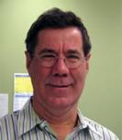
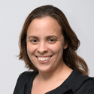
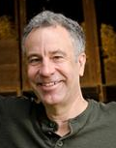
Bioinformatics Consulting
Lead | Bob Hohman | Justin Lack | Mariam Quiñones | Dean Follmann
Org | Research Technologies Branch (RTB/DIR) | NIAID Collaborative Bioinformatics Resource (NCBR/DIR) | Bioinformatics & Computational Biosciences Branch (BCBB/OCICB) | Biostatistics Research Branch (BRB/DCR)
Resources | Microscopy; Genomics; Flow Cytometry; Structural Biology; Visual & Medical Arts | 4 bioinformaticians, 1 sequencing support tech | 14+ bioinformaticians | 24 biostatisticians
Location | Campus, RML, Twinbrook | Building 29 | Building 31, RML, 5601 Fishers Lane | 5601 Fishers Lane
Web | https://myrtb.nih.gov | https://ncbr.ncifcrf.gov | https://bioinformatics.niaid.nih.gov | https://www.niaid.nih.gov
Notes:
Microscopy: Beth Fischer & Owen Schwartz
Genomics: Tim Myers & Craig Martens

Slide 13
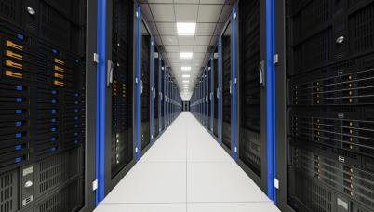
Locus
Summary
Key features: storage, GPUs, no cost!
Optimized for genomic analyses
Well-positioned for artificial intelligence and image analysis (medical and microscopy)
Compute
170 regular nodes (256 GB memory, 16 cores)
14 GPU nodes (24 GB memory, 4 GPUs)
2 high-memory nodes (768 GB, 32 cores)
2 super-high-memory nodes (3 TB, 32 cores)
Storage
Total storage: 2.2+ PB
No quotas on storage; 90-day backup
Additional Features
56 GB/s Infiniband
Fast file transfer with Globus
400+ apps with ability to easily add more
Singularity containers
BCBB are power users and advise you on use!
Notes:
Over 3000 compute cores
54 GPUs with nearly 270,000 total cores

Slide 14
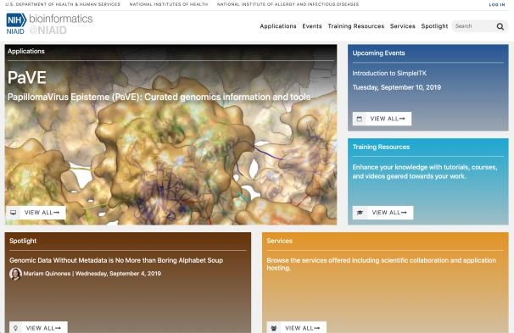
https://bioinformatics.niaid.nih.gov
One-Stop Shop for NIAID Bioinformatics
Consulting Services
Form
bioinformatics@niaid.nih.gov
Software Development & Infrastructure
Custom application development
Database development
Custom scripting

Slide 15
Training Materials
On-demand, publicly available
Slides (SlideShare)
Video (YouTube)
Code (GitHub)
Sample data (AWS)
Optimized for NIAID science and resources!

Slide 16
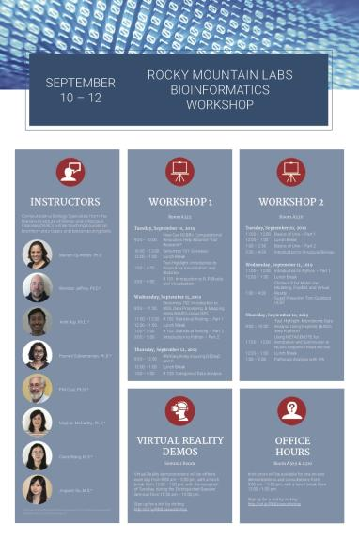
Hands-On Training This Week! https://niaid.github.io/RML/
Science: genomics, biostats, structural, microbiome, pathways analysis
Software: Nephele, METAGENOTE, ChimeraX, Geneious, Prism, IPA
Languages: UNIX, R, Python
One-on-one consultations
Virtual Reality demos

Slide 17
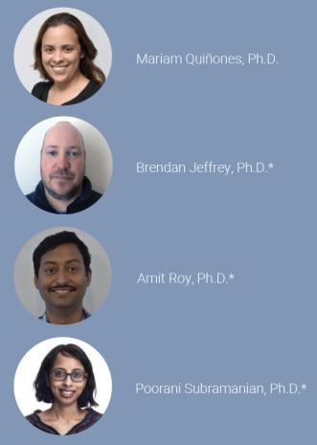
Instructors
Top areas of interest
Sample Recent Project
Genomics
Metagenomics
Molecular microbiology
Deployable variant analysis pipeline for Hendra and Nipah viruses. (PI: Robert Munford)
*Team Lead
Genomics
Transcriptomics
Virus and bacterial genomics
RNAseq and DNAseq analysis of Leishmania crosses (PI: David L. Sacks Lab)
RML
Structural biology
Modeling & simulation
CryoEM data analysis
Effect of mutations in function of ITK protein (PI: Jeff Cohen’s)
RML
Mathematics and computer science
Genomics
Metagenomics
Microbiome analysis of Rag1 mice (PI: Luigi Natalangelo’s and Julie Segre’s lab)

Slide 18
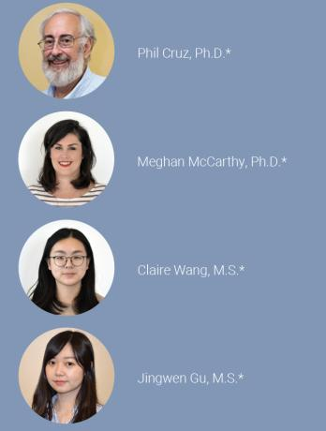
Instructors
Top areas of interest
Sample Recent Project
Structural Biology
Docking & simulation
Virtual Reality
3D printing
Augmented/Extended reality visualization & presentation app (PI: Barney Graham)
Virtual Reality
3D printing
Lead the effort on establishing VR technology in Uganda African Centers of Excellence
Clinical biostatistics
R programming
Machine Learning
Spearman correlation to compare data from naiive t cells after various treatments (PI: Pamela Guerrerio)
Clinical biostatistics
R programming
Data science
Answered consultation on use of linear mixed models to compare dysbiosis index in a complex study (PI :Yasmine Belkaid)

Slide 19
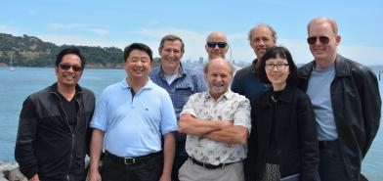
Guest Instructor Tom Goddard, UCSF
ChimeraX Programmer/Analyst
Volume data display (cryoEM & light microscopy)
Large molecular assemblies including integrative hybrid models
Virtual Reality
Notes:
VR has entered the mainstream is now driven by gaming and entertainment; therefore, technical advances will be rapid, affordability will increase, it will be more normal and expected by students
Technology Advances Make VR Viable
Goal is immersion (or “presence”); VR makes you feel like you’re present and experiencing things you may never get the opportunity to experience in real life

Slide 20
BioVisualization
NIH 3D Print Exchange & the NIAID Biovisualization Lab
3dprint@nih.gov
bioviz@mail.nih.gov
https://3dprint.nih.gov
14,000+ unique visitors/month;
>6700 published models;
about a million views of top 100 models;
>2400 registered users who have published models
Notes:
3DPX: 14,000+ unique visitors/month; >6700 published models; about a million views of top 100 models; >2400 registered users who have published models

Slide 21
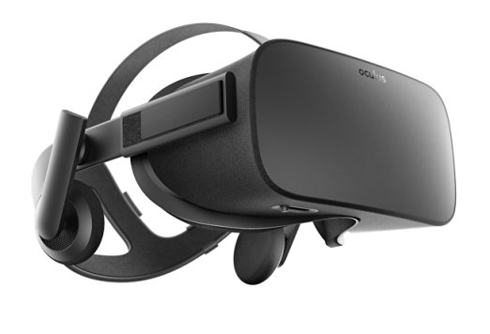
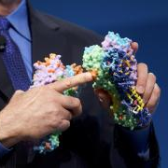
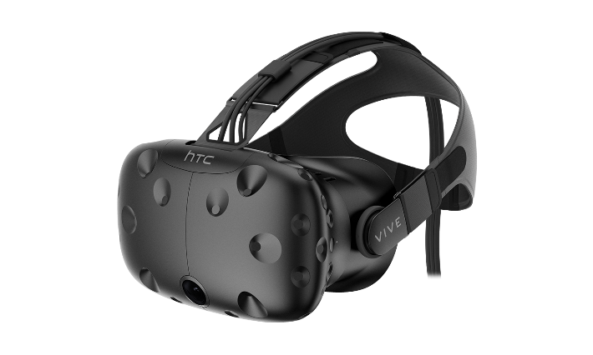
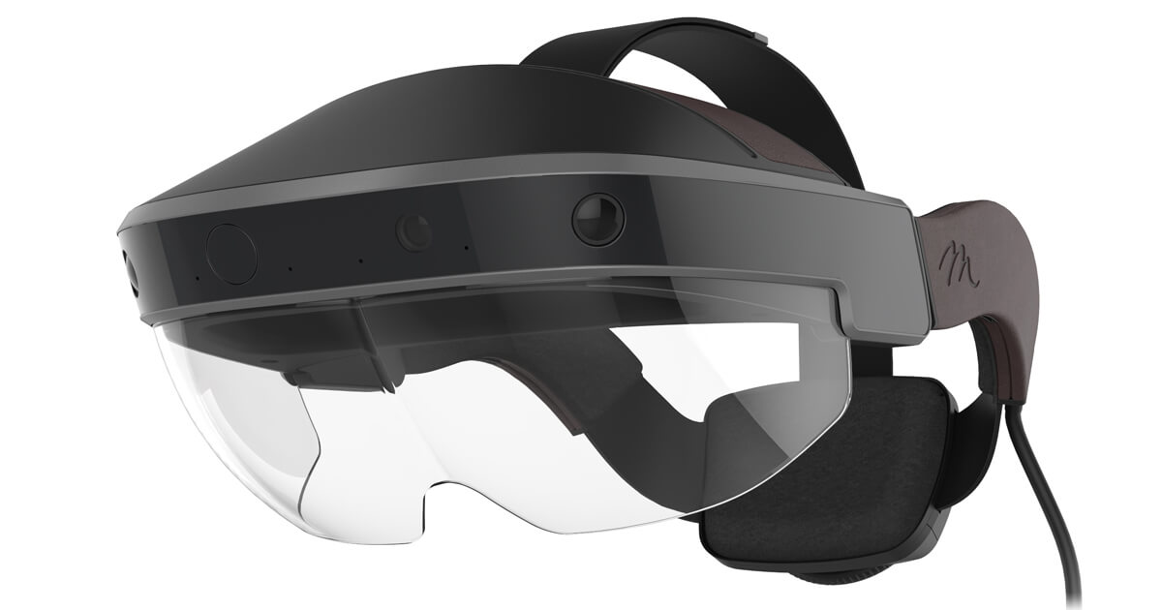
2007
2014
2015
2016
Notes:
3DPX: 14,000+ unique visitors/month; >6700 published models; about a million views of top 100 models; >2400 registered users who have published models

Slide 22
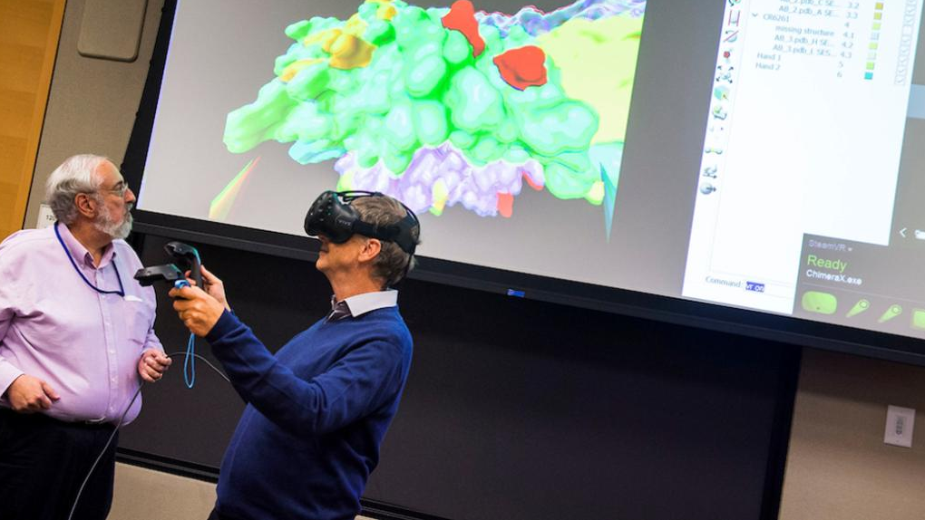
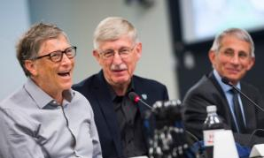
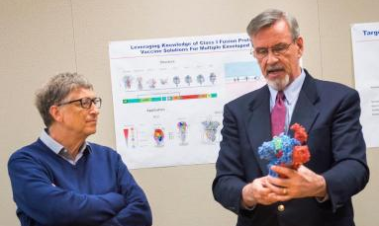
2017
Photos courtesy the National Institutes of Health
Read more at: https://nihrecord.nih.gov/newsletters/2017/06_30_2017/story4.htm

Slide 23
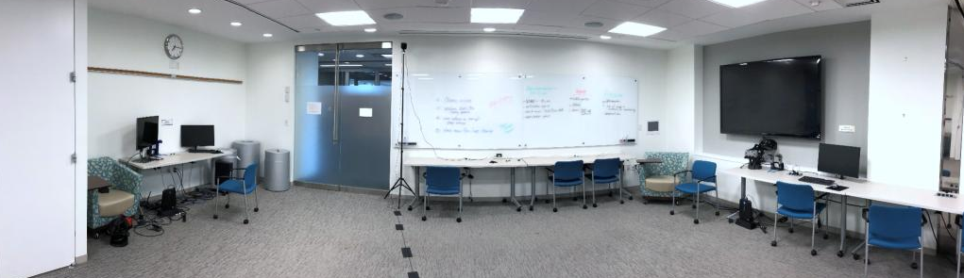
2018

Slide 24
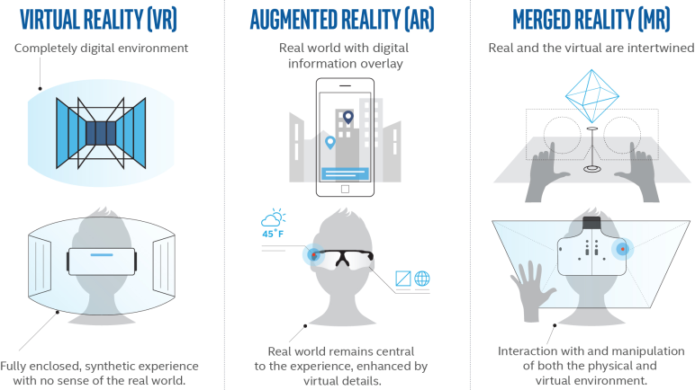
“Extended” Reality = XR
Deep concentration; research; individual learning
Contextual actions & information overlays
Group learning; increased retention(?)
VR makes you feel like you’re present and experiencing things you may never get the opportunity to experience in real life.
https://www.extremetech.com/extreme/249328-mixed-reality-can-take-augmented-reality-mainstream, http://mgl.scripps.edu/projects/tangible_models/
https://www.extremetech.com/extreme/249328-mixed-reality-can-take-augmented-reality-mainstream

Slide 25
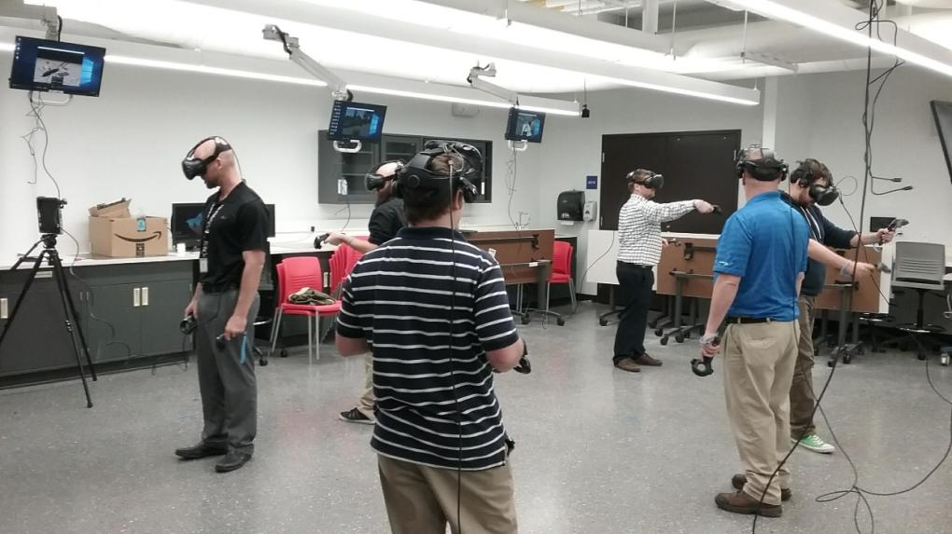
Model for the Biovisualization Lab The multiuser VR lab at University of Illinois, created by Enduvo, an official partner in launching the ACE Bioinformatics program at Makerere University in Uganda

Slide 26
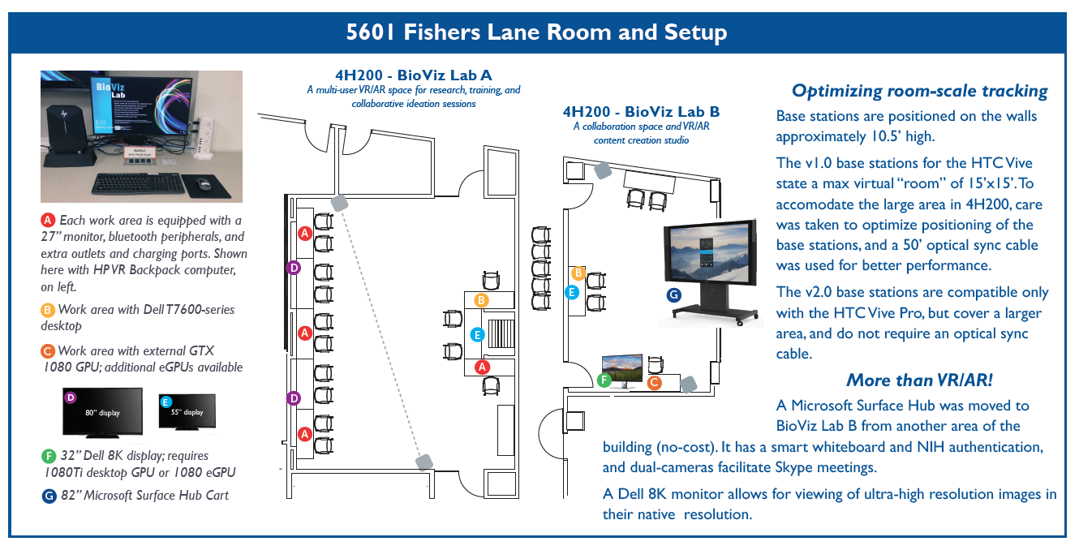

Slide 27
Data Visualization
Education and Training
Molecular visualization for structure exploration and drug discovery
Medical imaging scans
Large-scale networks and databases
Full microbial genome sequence visualization and alignment
Flow cytometry data
Scientific and non-scientific training
Clinical procedures and anatomy
Basic and BSL-4 laboratory orientation
Clinical center patient education
Emergency response and medical aid worker training (e.g., mass casualty events or disease outbreak areas)

Slide 28
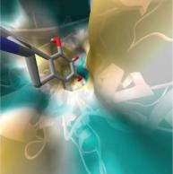
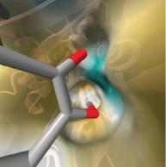
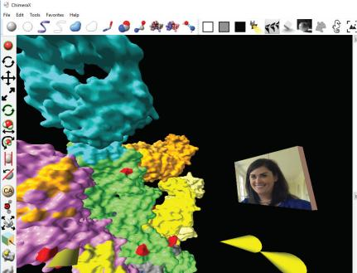
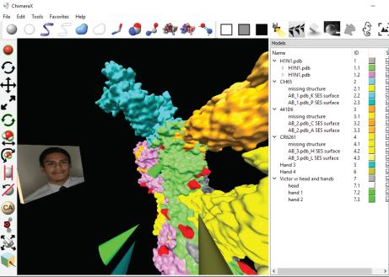
UCSF ChimeraX
http://rbvi.ucsf.edu/chimerax
http://vr.ucsf.edu
Molecular visualization unique vantage points to study structures and drug binding pockets that are impossible to see in an other environment

Slide 29
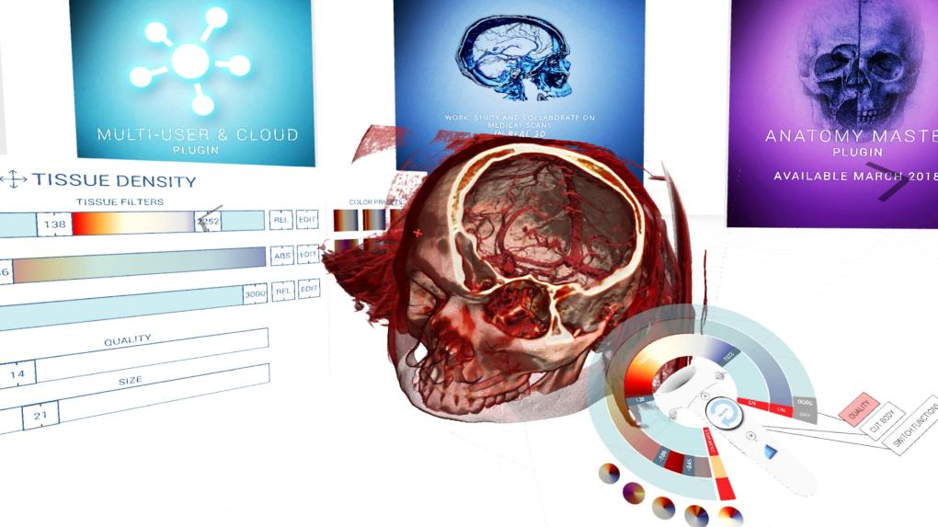
Medical Imaging Visualization Medical Holodeck

Slide 30
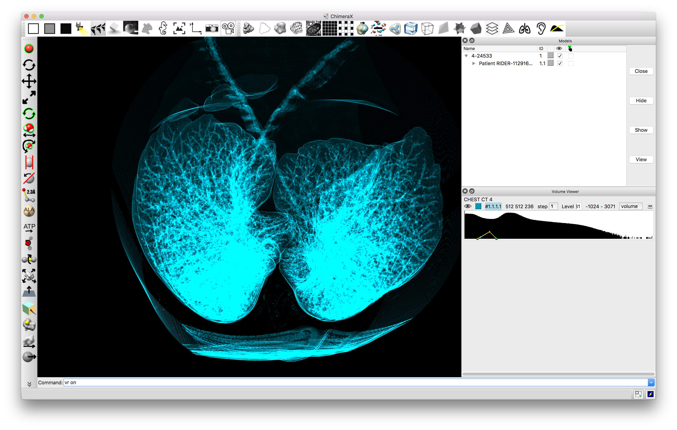
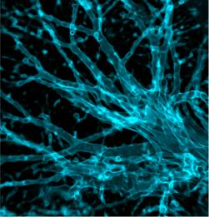
(Repurposing) ChimeraX for DICOM visualization
Tom Goddard, Programmer/Analyst, UCSF
http://vr.ucsf.edu/
http://rbvi.ucsf.edu/chimerax/

Slide 31
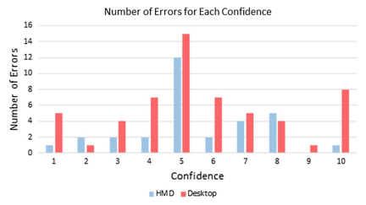
VR Training for Biomedical Science
Experiential learning and parallel information intake accelerate knowledge acquisition and boost recall accuracy
Virtual Reality journal; https://doi.org/10.1007/s10055-018-0346-3
Notes:
Education and Other Training Resources

Slide 33
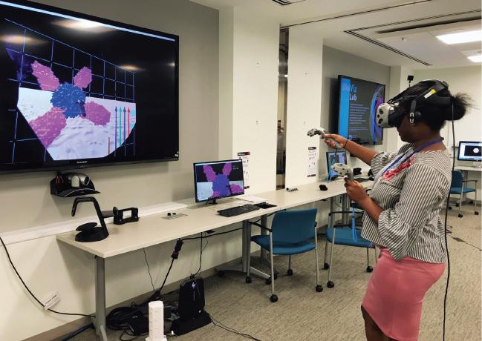
Content creation
made easy with

Slide 34
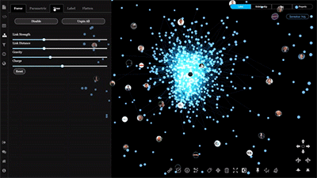
Now testing:
Network visualization
Multidimensional datasets
Enterprise applications

Slide 35
Large-Scale, High-Resolution Displays
Data visualization at its native scale: high resolution microscopy images
Comprehensive dataset visualization: full microbial genome alignment
Detailed dataset comparison: molecular structures, radiological data
Collaboration: document review and approval, remote meetings
“Situation Room” or Command Center

Slide 36
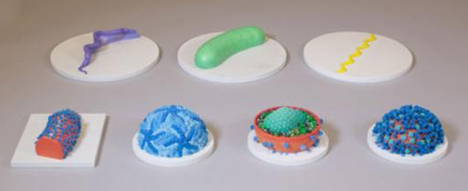
This week: consultations for 3D printing services
Meet with our team to discuss your needs
Share with us your own 3D model file or we can work with you to design the structure
3D prints are mailed to you in 2 to 6 weeks
Digital models designed by James Tyrwhitt-Drake, NIAID/OCICB
3D prints by Smithsonian, Photo courtesy Brigid Laurie
https://exhibits.si.edu/1-outbreak/

Slide 37
Virtual Reality – here at RML!
Demonstrations taking place in the Seminar room Tuesday through Thursday
Bring your own data or download from EMDB or PDB
Meet with ChimeraX developer, Tom Goddard, to learn what is coming in future and to share you own ideas and feature requests for bioscientific VR
Virtual reality services will be available at RML! Launch date and location TBD – contact bioviz@mail.nih.gov for information

Slide 38
https://bioinformatics.niaid.nih.gov
bioinformatics@niaid.nih.gov

